Slide 1

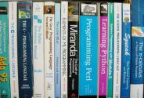

Object-Oriented Programming Fundamental Concepts
Svetlin Nakov
Telerik Corporation
www.telerik.com
Notes:
(c) 2006 National Academy for Software Development - http://academy.devbg.org*
1##

Slide 2

Contents
Fundamental Principles of OOP
Inheritance
Abstraction
Encapsulation
Polymorphism
Cohesion and Coupling

Slide 3

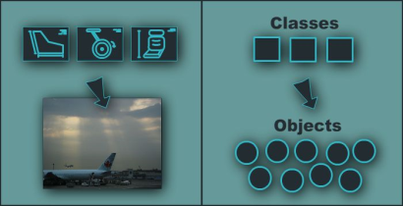
Fundamental Principles of OOP
Notes:
(c) 2006 National Academy for Software Development - http://academy.devbg.org*
3##

Slide 4
Fundamental Principles of OOP
Inheritance
Inherit members from parent class
Abstraction
Define and execute abstract actions
Encapsulation
Hide the internals of a class
Polymorphism
Access a class through its parent interface
4

Slide 5
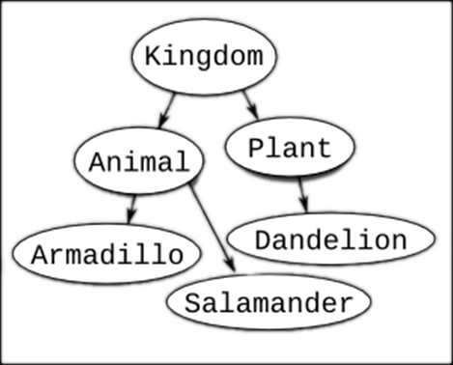
Inheritance
Notes:
(c) 2006 National Academy for Software Development - http://academy.devbg.org*
5##

Slide 6
Classes and Interfaces
Classes define attributes and behavior
Fields, properties, methods, etc.
Methods contain code for execution
Interfaces define a set of operations
Empty methods and properties, left to be implemented later
public class Labyrinth { … }
public interface IFigure { … }

Slide 7
Inheritance
Inheritance allows child classes inherits the characteristics of existing parent class
Attributes (fields and properties)
Operations (methods)
Child class can extend the parent class
Add new fields and methods
Redefine methods (modify existing behavior)
A class can implement an interface by providing implementation for all its methods
7

Slide 8
Types of Inheritance
Inheritance terminology
base class /
parent class
derived class
inherits
class
implements
interface
derived interface
implements
base interface
8

Slide 9

Inheritance – Benefits
Inheritance has a lot of benefits
Extensibility
Reusability
Provides abstraction
Eliminates redundant code
Use inheritance for buidling is-a relationships
E.g. dog is-a animal (dogs are kind of animals)
Don't use it to build has-a relationship
E.g. dog has-a name (dog is not kind of name)
9
Notes:
Extensibility / Polymorphism: New functionality may be easily plugged in without changing existing classes as long the new plug-in classes extend given base classes.
Reusability: For a set of similar applications a framework can be defined using a core set of classes that are to be extended by classes that fill in the application-dependent part.
Information Hiding: If a more general class using a simpler contract is sufficient, details from extending classes may be hidden to some of the client classes. This allows them to be more independent from possible changes and diminishes the load of contracts that must be understood by a reader of these client classes.
(c) 2006 National Academy for Software Development - http://academy.devbg.org*
9##

Slide 10
Inheritance – Example
Base class
Person
+Name: String
+Address: String
Derived class
Derived class
Employee
Student
+Company: String
+Salary: double
+School: String
10

Slide 11
Class Hierarchies
Inheritance leads to a hierarchy of classes and/or interfaces in an application:
Game
SinglePlayerGame
MultiplePlayersGame
Minesweeper
Solitaire
BoardGame
…
…
Chess
Backgammon
11

Slide 12
Inheritance in .NET
A class can inherit only one base class
E.g. IOException derives from SystemException and it derives from Exception
A class can implement several interfaces
This is .NET’s form of multiple inheritance
E.g. List<T> implements IList<T>, ICollection<T>, IEnumerable<T>
An interface can implement several interfaces
E.g. IList<T> implements ICollection<T> and IEnumerable<T>
12

Slide 13


How to Define Inheritance?
We must specify the name of the base class after the name of the derived
In the constructor of the derived class we use the keyword base to invoke the constructor of the base class
public class Shape
{...}
public class Circle : Shape
{...}
public Circle (int x, int y) : base(x)
{...}

Slide 14
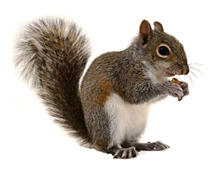
Simple Inheritance Example
public class Mammal
{
public int Age { get; set; }
public Mammal(int age)
{
this.Age = age;
}
public void Sleep()
{
Console.WriteLine("Shhh! I'm sleeping!");
}
}

Slide 15

Simple Inheritance Example (2)
public class Dog : Mammal
{
public string Breed { get; set; }
public Dog(int age, string breed)
: base(age)
{
this.Breed = breed;
}
public void WagTail()
{
Console.WriteLine("Tail wagging...");
}
}

Slide 16

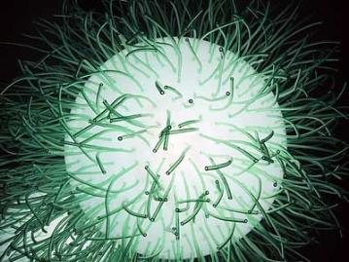
Simple Inheritance
Live Demo

Slide 17
Accessibility Levels
Access modifiers in C#
public – access is not restricted
private – access is restricted to the containing type
protected – access is limited to the containing type and types derived from it
internal – access is limited to the current assembly
protected internal – access is limited to the current assembly or types derived from the containing class

Slide 18
Inheritance and Accessibility
class Creature
{
protected string Name { get; private set; }
private void Talk()
{
Console.WriteLine("I am creature ...");
}
protected void Walk()
{
Console.WriteLine("Walking ...");
}
}
class Mammal : Creature
{
// base.Talk() can be invoked here
// this.Name can be read but cannot be modified here
}

Slide 19
Inheritance and Accessibility (2)
class Dog : Mammal
{
public string Breed { get; private set; }
// base.Talk() cannot be invoked here (it is private)
}
class InheritanceAndAccessibility
{
static void Main()
{
Dog joe = new Dog(6, "Labrador");
Console.WriteLine(joe.Breed);
// joe.Walk() is protected and can not be invoked
// joe.Talk() is private and can not be invoked
// joe.Name = "Rex"; // Name cannot be accessed here
// joe.Breed = "Shih Tzu"; // Can't modify Breed
}
}

Slide 20

Inheritance and Accessibility
Live Demo

Slide 21
Inheritance: Important Aspects
Structures cannot be inherited
In C# there is no multiple inheritance
Only multiple interfaces can be implemented
Instance and static constructors are not inherited
Inheritance is transitive relation
If C is derived from B, and B is derived from A, then C inherits A as well

Slide 22
Inheritance: Important Features
A derived class extends its base class
It can add new members but cannot remove derived ones
Declaring new members with the same name or signature hides the inherited ones
A class can declare virtual methods and properties
Derived classes can override the implementation of these members
E.g. Object.Equals() is virtual method

Slide 23



Abstraction
Notes:
(c) 2006 National Academy for Software Development - http://academy.devbg.org*
23##

Slide 24

Abstraction
Abstraction means ignoring irrelevant features, properties, or functions and emphasizing the relevant ones ...
... relevant to the given project (with an eye to future reuse in similar projects)
Abstraction = managing complexity
"Relevant" to what?
24

Slide 25
Abstraction (2)
Abstraction is something we do every day
Looking at an object, we see those things about it that have meaning to us
We abstract the properties of the object, and keep only what we need
E.g. students get "name" but not "color of eyes"
Allows us to represent a complex reality in terms of a simplified model
Abstraction highlights the properties of an entity that we need and hides the others
25

Slide 26

Abstraction in .NET
In .NET abstraction is achieved in several ways:
Abstract classes
Interfaces
Inheritance
Control
+click()
ButtonBase
+Color : long
Button
RadioButton
CheckBox
26

Slide 27
Abstraction in .NET – Example
System.Object
System.MarshalByRefObject
System.ComponentModel.Component
System.Windows.Forms.Control
System.Windows.Forms.ButtonBase
System.Windows.Forms.Button
27

Slide 28
Interfaces in C#
An interface is a set of operations (methods) that given object can perform
Also called "contract" for supplying a set of operations
Defines abstract behavior
Interfaces provide abstractions
You shouldn't have to know anything about what is in the implementation in order to use it
28

Slide 29
Abstract Classes in C#
Abstract classes are special classes defined with the keyword abstract
Mix between class and interface
Partially implemented or fully unimplemented
Not implemented methods are declared abstract and are left empty
Cannot be instantiated
Child classes should implement abstract methods or declare them as abstract
29

Slide 30

Abstract Data Types
Abstract Data Types (ADT) are data types defined by a set of operations (interface)
Example:
«interface»
IList<T>
+Add(item : Object)
+Remove(item : Object)
+Clear()
…
LinkedList<T>
List<T>
30

Slide 31
Inheritance Hierarchies
Using inheritance we can create inheritance hierarchies
Easily represented by UML class diagrams
UML class diagrams
Classes are represented by rectangles containing their methods and data
Relations between classes are shown as arrows
Closed triangle arrow means inheritance
Other arrows mean some kind of associations

Slide 32
UML Class Diagram – Example
interface
Shape
struct
ISurfaceCalculatable
Point
#Position:Point
+CalculateSurface:float
+X:int
+Y:int
+Point
Square
Rectangle
struct
Color
-Size:float
-Width:float
-Height:float
+RedValue:byte
+Square
+GreenValue:byte
+CalculateSurface:float
+Rectangle
+BlueValue:byte
+CalculateSurface:float
+Color
FilledSquare
FilledRectangle
-Color:Color
-Color:Color
+FilledSquare
+FilledRectangle

Slide 33
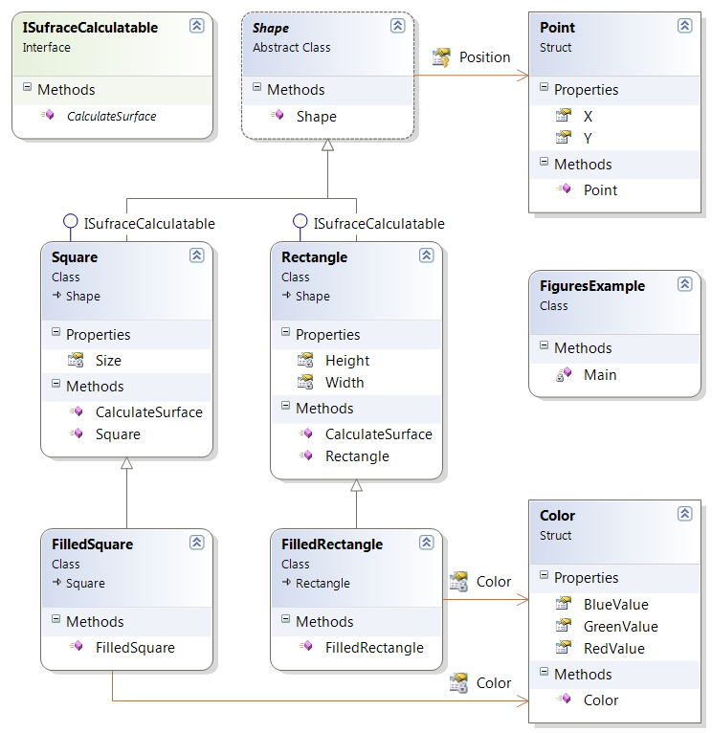
Class Diagrams in Visual Studio
Live Demo

Slide 34



Encapsulation
Notes:
(c) 2006 National Academy for Software Development - http://academy.devbg.org*
34##

Slide 35
Encapsulation
Encapsulation hides the implementation details
Class announces some operations (methods) available for its clients – its public interface
All data members (fields) of a class should be hidden
Accessed via properties (read-only and read-write)
No interface members should be hidden
35

Slide 36
Encapsulation – Example
Data fields are private
Constructors and accessors are defined (getters and setters)
Person
-name : string
-age : TimeSpan
+Person(string name, int age)
+Name : string { get; set; }
+Age : TimeSpan { get; set; }
36

Slide 37
Encapsulation in .NET
Fields are always declared private
Accessed through properties in read-only or read-write mode
Constructors are almost always declared public
Interface methods are always public
Not explicitly declared with public
Non-interface methods are declared private / protected
37

Slide 38
Encapsulation – Benefits
Ensures that structural changes remain local:
Changing the class internals does not affect any code outside of the class
Changing methods' implementation does not reflect the clients using them
Encapsulation allows adding some logic when accessing client's data
E.g. validation on modifying a property value
Hiding implementation details reduces complexity → easier maintenance
38

Slide 39
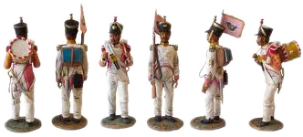
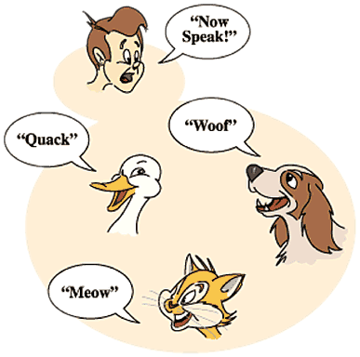
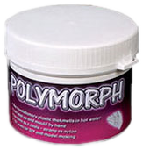
Polymorphism
Notes:
(c) 2006 National Academy for Software Development - http://academy.devbg.org*
39##

Slide 40
Polymorphism
Polymorphism = ability to take more than one form (objects have more than one type)
A class can be used through its parent interface
A child class may override some of the behaviors of the parent class
Polymorphism allows abstract operations to be defined and used
Abstract operations are defined in the base class' interface and implemented in the child classes
Declared as abstract or virtual
40

Slide 41
Polymorphism (2)
Why handle an object of given type as object of its base type?
To invoke abstract operations
To mix different related types in the same collection
E.g. List<object> can hold anything
To pass more specific object to a method that expects a parameter of a more generic type
To declare a more generic field which will be initialized and "specialized" later
41

Slide 42
Virtual Methods
Virtual method is method that can be used in the same way on instances of base and derived classes but its implementation is different
A method is said to be a virtual when it is declared as virtual
Methods that are declared as virtual in a base class can be overridden using the keyword override in the derived class
public virtual void CalculateSurface()

Slide 43
The override Modifier
Using override we can modify a method or property
An override method provides a new implementation of a member inherited from a base class
You cannot override a non-virtual or static method
The overridden base method must be virtual, abstract, or override

Slide 44
Polymorphism – How it Works?
Polymorphism ensures that the appropriate method of the subclass is called through its base class' interface
Polymorphism is implemented using a technique called late method binding
Exact method to be called is determined at runtime, just before performing the call
Applied for all abstract / virtual methods
Note: Late binding is slower than normal (early) binding
44

Slide 45
Polymorphism – Example
Abstract class
Figure
Abstract action
+CalcSurface() : double
Concrete class
Square
Circle
-x : int
-y : int
-size : int
-x : int
-y : int
-radius: int
Overriden action
Overriden action
override CalcSurface()
{
return size * size;
}
override CalcSurface()
{
return PI * radius * raduis;
}
45

Slide 46
Polymorphism – Example (2)
abstract class Figure
{
public abstract double CalcSurface();
}
abstract class Square
{
public override double CalcSurface() { return … }
}
Figure f1 = new Square(...);
Figure f2 = new Circle(...);
// This will call Square.CalcSurface()
int surface = f1.CalcSurface();
// This will call Square.CalcSurface()
int surface = f2.CalcSurface();

Slide 47
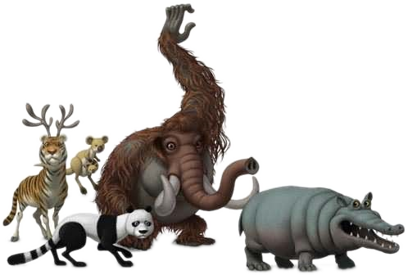
Polymorphism
Live Demo
Notes:
(c) 2006 National Academy for Software Development - http://academy.devbg.org*
47##

Slide 48
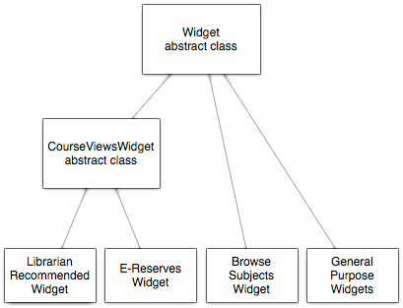
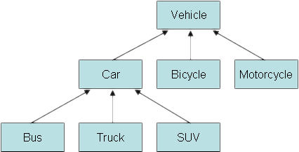
Class Hierarchies: Real World Example
Notes:
(c) 2006 National Academy for Software Development - http://academy.devbg.org*
48##

Slide 49
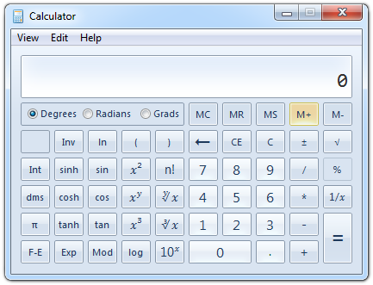
Real World Example: Calculator
Creating an application like the Windows Calculator
Typical scenario for applying the object-oriented approach
49

Slide 50
Real World Example: Calculator (2)
The calculator consists of controls:
Buttons, panels, text boxes, menus, check boxes, radio buttons, etc.
Class Control – the root of our OO hierarchy
All controls can be painted on the screen
Should implement an interface IPaintable with a method Paint()
Common properties: location, size, text, face color, font, background color, etc.
50

Slide 51
Real World Example: Calculator (3)
Some controls could contain other (nested) controls inside (e. g. panels and toolbars)
We should have class Container that extends Control holding a collection of child controls
The Calculator itself is a Form
Form is a special kind of Container
Contains also border, title (text derived from Control), icon and system buttons
How the Calculator paints itself?
Invokes Paint() for all child controls inside it
51

Slide 52
Real World Example: Calculator (4)
How a Container paints itself?
Invokes Paint() for all controls inside it
Each control knows how to visualize itself
What is the common between buttons, check boxes and radio buttons?
Can be pressed
Can be selected
We can define class AbstractButton and all buttons can derive from it
52

Slide 53
Calculator Classes
«interface»
IPaintable
Paint()
Control
-location
-size
-text
-bgColor
-faceColor
-font
Container
AbstractButton
TextBox
MainMenu
MenuItem
Panel
Form
Button
CheckBox
RadioButton
Calculator
53

Slide 54

Cohesion and Coupling

Slide 55
Cohesion
Cohesion describes how closely all the routines in a class or all the code in a routine support a central purpose
Cohesion must be strong
Well-defined abstractions keep cohesion strong
Classes must contain strongly related functionality and aim for single purpose
Cohesion is a useful tool for managing complexity

Slide 56


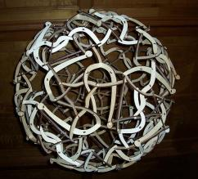
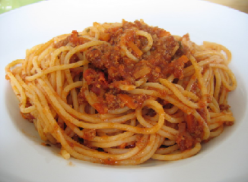
Good and Bad Cohesion
Good: hard disk, cdrom, floppy
BAD: spaghetti code

Slide 57
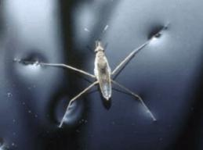
Strong Cohesion
Strong cohesion example
Class Math that has methods:
Sin(), Cos(), Asin()
Sqrt(), Pow(), Exp()
Math.PI, Math.E
double sideA = 40, sideB = 69;
double angleAB = Math.PI / 3;
double sideC =
Math.Pow(sideA, 2) + Math.Pow(sideB, 2)
- 2 * sideA * sideB * Math.Cos(angleAB);
double sidesSqrtSum = Math.Sqrt(sideA) + Math.Sqrt(sideB) + Math.Sqrt(sideC);

Slide 58
Bad Cohesion
Bad cohesion example
Class Magic that has these methods:
Another example:
public void PrintDocument(Document d);
public void SendEmail(
string recipient, string subject, string text);
public void CalculateDistanceBetweenPoints(
int x1, int y1, int x2, int y2)
MagicClass.MakePizza("Fat Pepperoni");
MagicClass.WithdrawMoney("999e6");
MagicClass.OpenDBConnection();

Slide 59
Coupling
Coupling describes how tightly a class or routine is related to other classes or routines
Coupling must be kept loose
Modules must depend little on each other
All classes and routines must have small, direct, visible, and flexible relations to other classes and routines
One module must be easily used by other modules

Slide 60
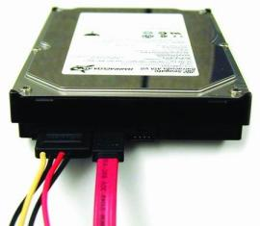
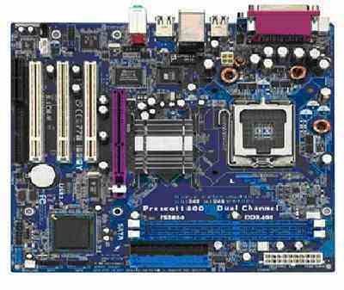
Loose and Tight Coupling
Loose Coupling:
Easily replace old HDD
Easily place this HDD to another motherboard
Tight Coupling:
Where is the video adapter?
Can you change the video controller?

Slide 61
Loose Coupling – Example
class Report
{
public bool LoadFromFile(string fileName) {…}
public bool SaveToFile(string fileName) {…}
}
class Printer
{
public static int Print(Report report) {…}
}
class Program
{
static void Main()
{
Report myReport = new Report();
myReport.LoadFromFile("C:\\DailyReport.rep");
Printer.Print(myReport);
}
}

Slide 62
Tight Coupling – Example
class MathParams
{
public static double operand;
public static double result;
}
class MathUtil
{
public static void Sqrt()
{
MathParams.result = CalcSqrt(MathParams.operand);
}
}
class MainClass
{
static void Main()
{
MathParams.operand = 64;
MathUtil.Sqrt();
Console.WriteLine(MathParams.result);
}
}

Slide 63
Spaghetti Code
Combination of bad cohesion and tight coupling:
class Report
{
public void Print() {…}
public void InitPrinter() {…}
public void LoadPrinterDriver(string fileName) {…}
public bool SaveReport(string fileName) {…}
public void SetPrinter(string printer) {…}
}
class Printer
{
public void SetFileName() {…}
public static bool LoadReport() {…}
public static bool CheckReport() {…}
}

Slide 64
Summary
OOP fundamental principals are: inheritance, encapsulation, abstraction, polymorphism
Inheritance allows inheriting members form another class
Abstraction and encapsulation hide internal data and allow working through abstract interface
Polymorphism allows working with objects through their parent interface and invoke abstract actions
Strong cohesion and loose coupling avoid spaghetti code

Slide 65


Object-Oriented Programming Fundamental Concepts
Questions?
http://academy.telerik.com

